Slide 1
Curing Amnesia and other GPU maladies with AMD developer tools
Amit Ben-Moshe, Chris Hesik, Gordon Selley

Slide 2
ABOUT THIS Presentation
Update on the RadeonTM GPU Analyzer
What’s new with the RadeonTM GPU Profiler?
The new AMD RadeonTM Memory Visualizer

Slide 3
Update on the Radeon™ GPU Analyzer
Authored by Amit Ben-Moshe
Presented by Gordon Selley

Slide 4
Radeon™ GPU Analyzer (RGA)
Shader compiler and code analysis tool
Generates ISA disassembly for RDNA/GCN
Intermediate language (IL) for AMD-IL, SPIR-V and DX-IL
Retrieve shader HW resource usage information for:
VGPR and SGPR consumption, register spills, local data share allocation, scratch memory usage
Static analysis
Live VGPR analysis, control flow graph
Independent of the installed GPU
(e.g. have Polaris and analyze for Navi)
Available for Linux® and Windows®
Supports DirectX®12, DirectX®11, Vulkan®, OpenGL™, OpenCL™

Slide 5
RGA Integration with other tools
RGA is used in RenderDoc, Shader Playground, and CodeXL

Slide 6
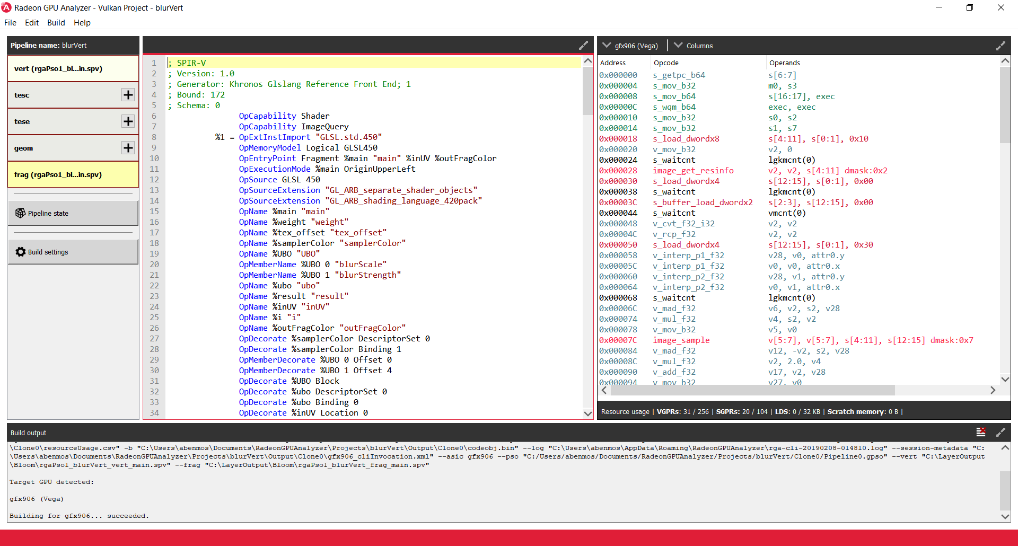
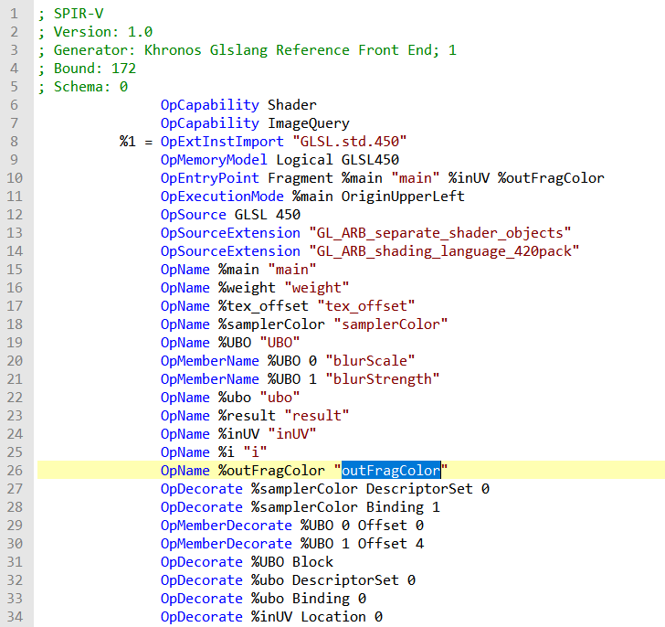
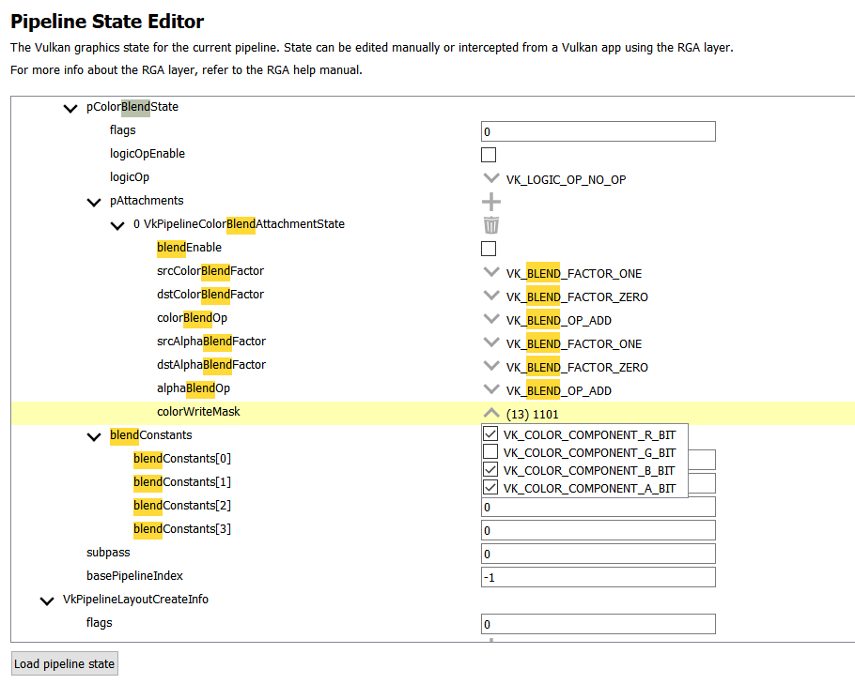
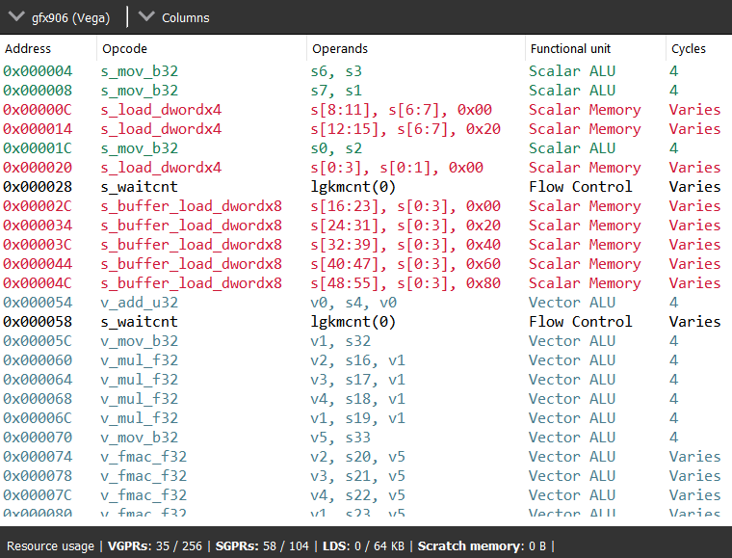
RGA IN GDC 2019
RGA 2.1 for Vulkan
New approach for shader optimization
What you see is what you get
Compiler updates as you update the driver
New GUI for compiling Vulkan pipelines
SPIR-V binary and GLSL source code editor
Pipeline state editor
Disassembly view with instruction color coding
Single line resource usage view
Resource limit warnings

Slide 7
RGA New Features
Added support for the latest Radeon™ RX 5000 series (RDNA) GPU’s
DirectX® 12 Compute added in RGA 2.2
DirectX® 12 Graphics added in RGA 2.3

Slide 8
DirectX® 12 support in rga
Command line level
Big advantage over DirectX® 11 mode:
New driver stack: what you see is what you get
Supports all RGA’s features: disassembly, HW stats, analysis
RGA can target AMD GPU’s that are not physically installed

Slide 9
DirectX® 12 compute
Two required inputs:
Shaders
Root signature
Input may come in one of two forms:
HLSL source code
DXIL/DXBC binary
Plug & play using --dxc option

Slide 10
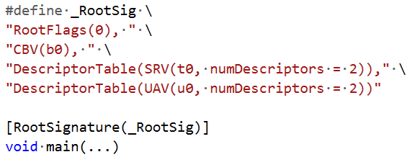
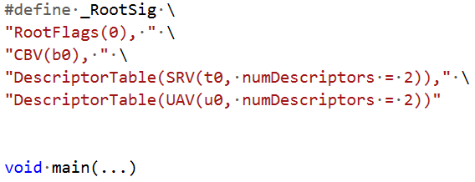
DirectX® 12 compute
Root signatures - 3 scenarios:
[RootSignature()] attribute for shader in HLSL code
All set!
Macro defined but attribute not used
Use --rs-macro <macro name>
Two pass compilation
Precompiled blob
Use --rs-bin <path to blob>

Slide 11
DirectX® 12 compute
Example – [RootSignature()] attribute in HLSL:
rga -s dx12 --cs C:\FillLightGridCS_8.hlsl --cs-entry main --cs-model cs_5_1 --isa C:\disassembly.txt
Command break down:
--cs HLSL file where compute shader is defined
--cs-entry Entrypoint name
--cs-model Shader model (target) to be used (e.g. cs_5_1)
--isa Output file path for ISA disassembly
Root signature not needed!
If only [RootSignature()] is missing, add --rs-macro <macro name>
If pre-compiled, add --rs-bin <path>

Slide 12
DirectX® 12 graphics
Same usage as for compute (almost!)
Same command (replace --cs with --vs,--hs etc.)
Root signatures behave the same
What’s missing?
Let’s look at the compilation flow for DirectX® 12:
Missing element:
Graphics pipeline state
DX12Backend.exe

Slide 13
DirectX® 12 graphics
.gpso file:
Defines the minimum required pipeline state
Can generate using the --gpso-template option
Text based
Easy to cut & paste from source code

Slide 14
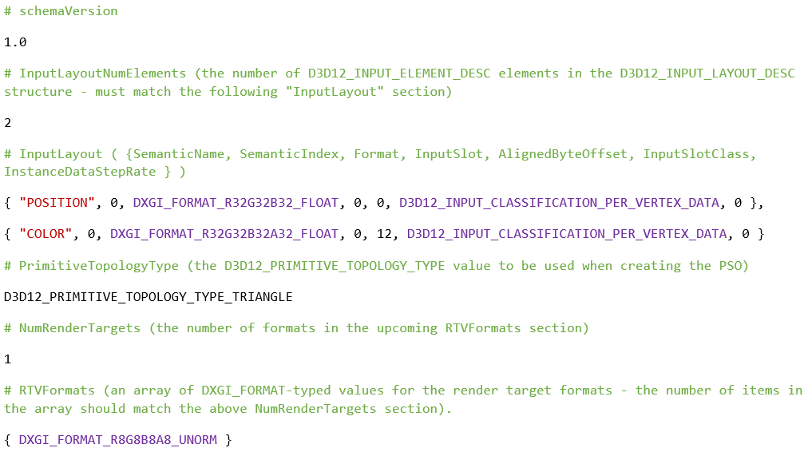

Slide 15
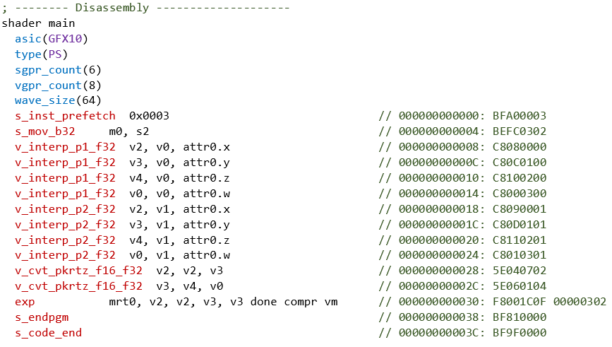
DirectX® 12 graphics
Summary – 3 requirements:
Shaders
Root signature
.gpso file
It’s easy!

Slide 16
THANK YOU
Find out more at GPUOpen
www.gpuopen.com
Download RGA from GitHub:
https://github.com/GPUOpen-Tools/radeon_gpu_analyzer/releases

Slide 17
Copyright & Disclaimer
© 2020 Advanced Micro Devices, Inc. All rights reserved.
AMD, the AMD Arrow logo, Radeon and combinations thereof are trademarks of Advanced Micro Devices, Inc. Other product names used in this publication are for identification purposes only and may be trademarks of their respective companies.
DirectX® is a registered trademark of Microsoft Corporation in the US and other jurisdictions.
Linux® is the registered trademark of Linus Torvalds in the U.S. and other countries.
OpenCL™ is a trademark of Apple Inc. used by permission by Khronos Group, Inc.
OpenGL® and the oval logo are trademarks or registered trademarks of Hewlett Packard Enterprise in the United States and/or other countries worldwide.
Vulkan® and the Vulkan logo are registered trademarks of the Khronos Group Inc.
Windows® is a registered trademark of Microsoft Corporation in the US and other jurisdictions.
Disclaimer
The information presented in this document is for informational purposes only and may contain technical inaccuracies, omissions, and typographical errors. The information contained herein is subject to change and may be rendered inaccurate for many reasons, including but not limited to product and roadmap changes, component and motherboard version changes, new model and/or product releases, product differences between differing manufacturers, software changes, BIOS flashes, firmware upgrades, or the like. Any computer system has risks of security vulnerabilities that cannot be completely prevented or mitigated. AMD assumes no obligation to update or otherwise correct or revise this information. However, AMD reserves the right to revise this information and to make changes from time to time to the content hereof without obligation of AMD to notify any person of such revisions or changes.
THIS INFORMATION IS PROVIDED ‘AS IS.” AMD MAKES NO REPRESENTATIONS OR WARRANTIES WITH RESPECT TO THE CONTENTS HEREOF AND ASSUMES NO RESPONSIBILITY FOR ANY INACCURACIES, ERRORS, OR OMISSIONS THAT MAY APPEAR IN THIS INFORMATION. AMD SPECIFICALLY DISCLAIMS ANY IMPLIED WARRANTIES OF NON-INFRINGEMENT, MERCHANTABILITY, OR FITNESS FOR ANY PARTICULAR PURPOSE. IN NO EVENT WILL AMD BE LIABLE TO ANY PERSON FOR ANY RELIANCE, DIRECT, INDIRECT, SPECIAL, OR OTHER CONSEQUENTIAL DAMAGES ARISING FROM THE USE OF ANY INFORMATION CONTAINED HEREIN, EVEN IF AMD IS EXPRESSLY ADVISED OF THE POSSIBILITY OF SUCH DAMAGES.

Slide 18
Curing Amnesia and other GPU maladies with AMD developer tools
Amit Ben-Moshe, Chris Hesik, Gordon Selley

Slide 19
ABOUT THIS Presentation
Update on the RadeonTM GPU Analyzer
What’s new with the RadeonTM GPU Profiler?
The new AMD RadeonTM Memory Visualizer

Slide 20
What’s new with the RadeonTM GPU Profiler?
Authored by Chris Hesik
Presented by Gordon Selley

Slide 21
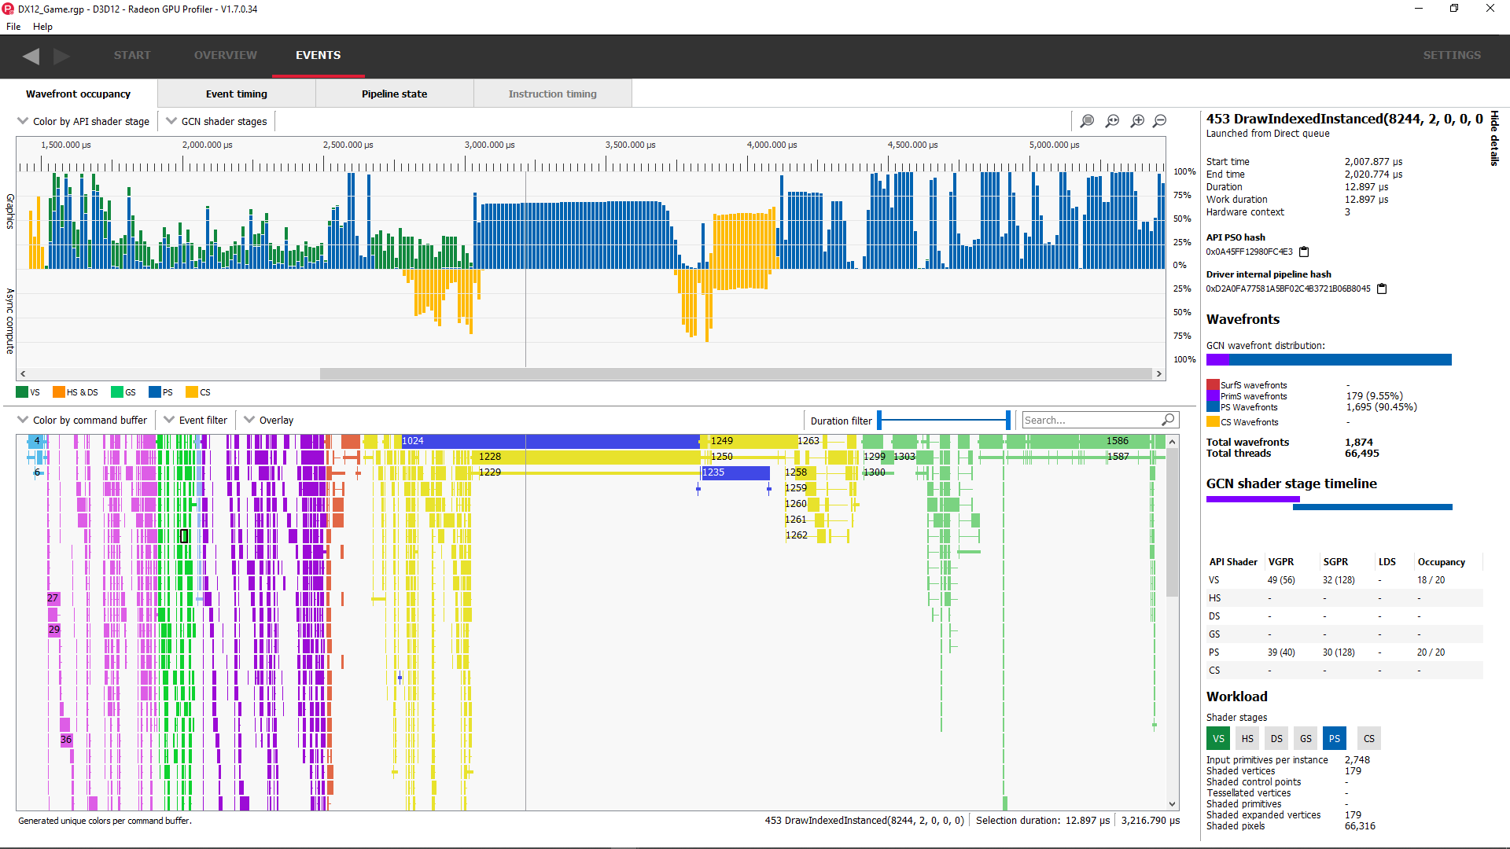
What is RADEON™ GPU PROFILER?
GPU performance analysis tool
Shows low level profiling data
Visualizes GPU workloads
Identify performance bottlenecks
Bridge the gap between APIs and RDNA/GCN
Designed to support
Linux® and Windows®
Vulkan®, DirectX® 12, and OpenCL™

Slide 22
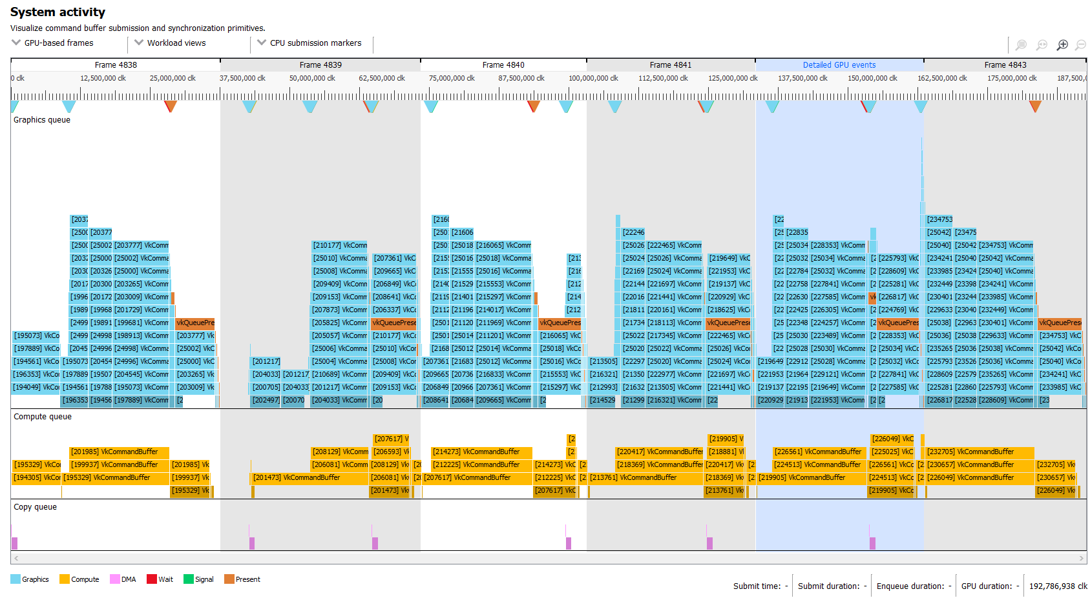
GDC 2019 – RGP 1.4
Overview
Frame Summary
Barriers
Context rolls
Most expensive events
Render/depth targets
Events
Wavefront occupancy
Event timing
Pipeline state

Slide 23
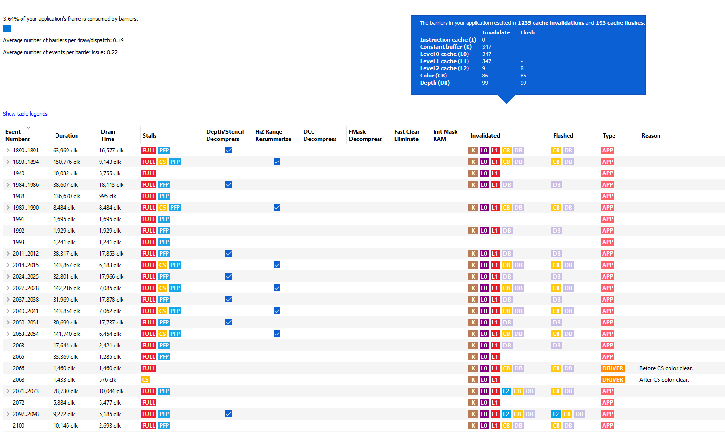
GDC 2019 – RGP 1.4
Overview
Frame Summary
Barriers
Context rolls
Most expensive events
Render/depth targets
Events
Wavefront occupancy
Event timing
Pipeline state

Slide 24
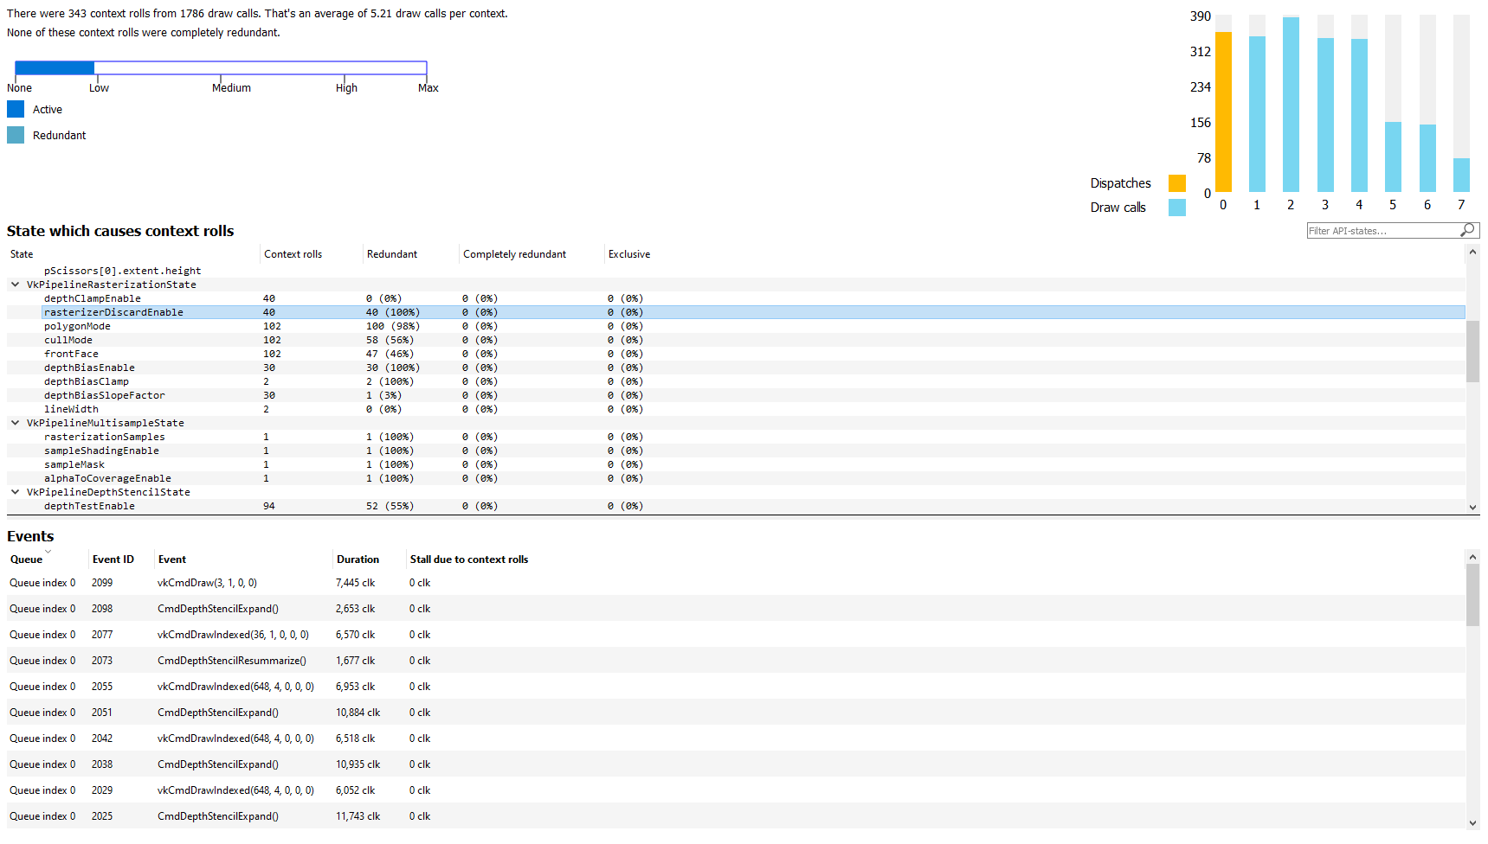
GDC 2019 – RGP 1.4
Overview
Frame Summary
Barriers
Context rolls
Most expensive events
Render/depth targets
Events
Wavefront occupancy
Event timing
Pipeline state

Slide 25
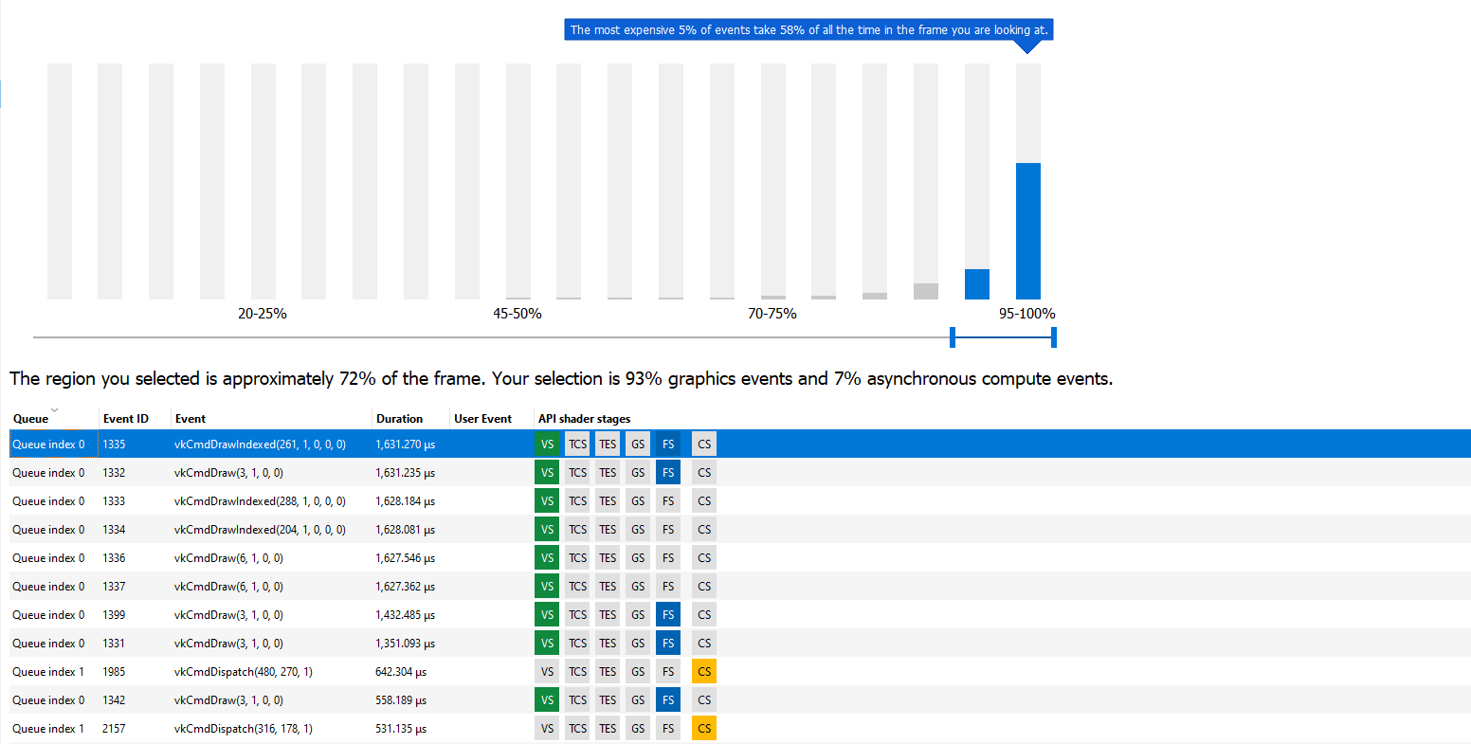
GDC 2019 – RGP 1.4
Overview
Frame Summary
Barriers
Context rolls
Most expensive events
Render/depth targets
Events
Wavefront occupancy
Event timing
Pipeline state

Slide 26
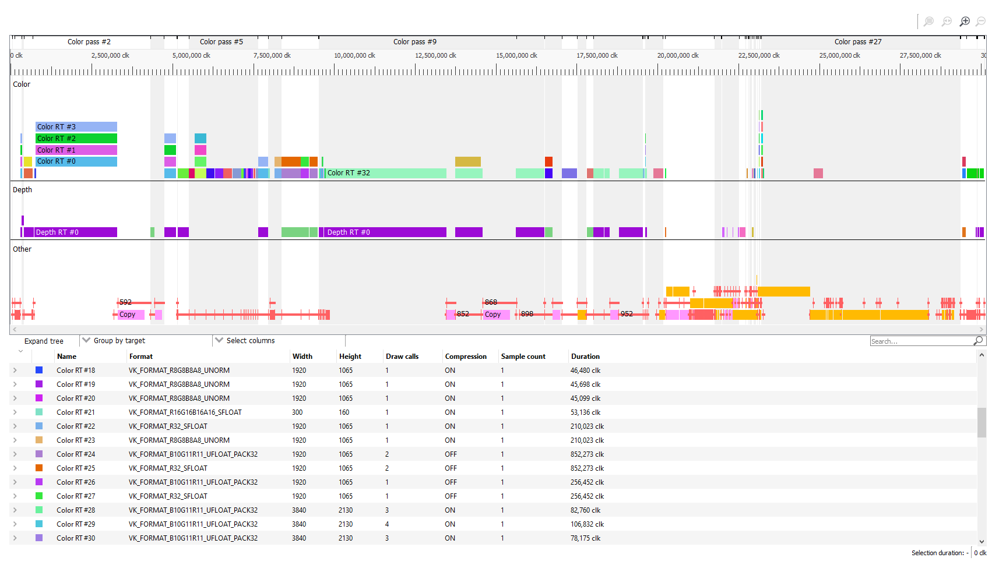
GDC 2019 – RGP 1.4
Overview
Frame Summary
Barriers
Context rolls
Most expensive events
Render/depth targets
Events
Wavefront occupancy
Event timing
Pipeline state

Slide 27
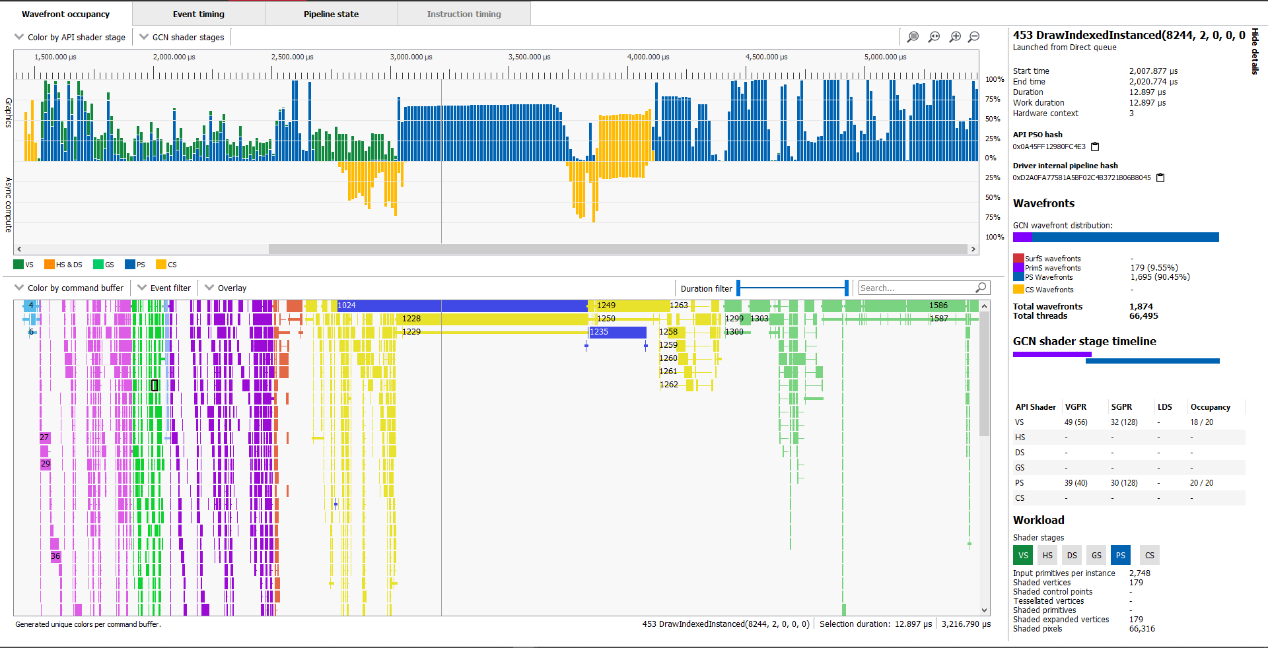
GDC 2019 – RGP 1.4
Overview
Frame Summary
Barriers
Context rolls
Most expensive events
Render/depth targets
Events
Wavefront occupancy
Event timing
Pipeline state

Slide 28
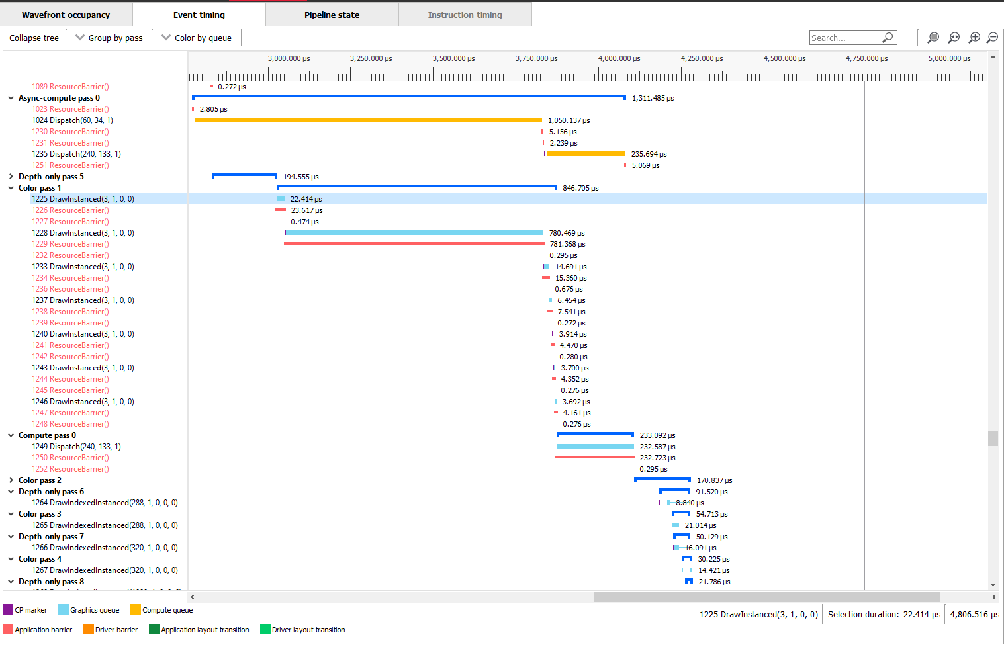
GDC 2019 – RGP 1.4
Overview
Frame Summary
Barriers
Context rolls
Most expensive events
Render/depth targets
Events
Wavefront occupancy
Event timing
Pipeline state

Slide 29
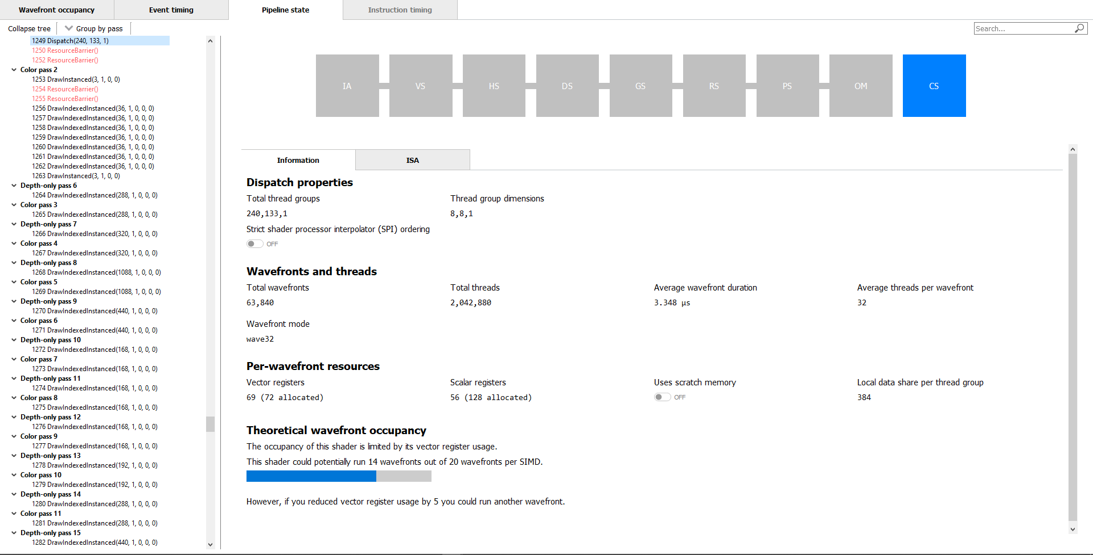
GDC 2019 – RGP 1.4
Overview
Frame Summary
Barriers
Context rolls
Most expensive events
Render/depth targets
Events
Wavefront occupancy
Event timing
Pipeline state

Slide 30
That’s Great, BUT…
What’s New?

Slide 31
RDNA Support
Seamless

Slide 32
RDNA Support
Seamless
New hardware pipeline

Slide 33
RDNA Support
Seamless
New hardware pipeline
wave32/wave64

Slide 34
RDNA Support
Seamless
New hardware pipeline
wave32/wave64
Barriers show extra cache level L0/L1/L2

Slide 35
Pipelines Overview

Slide 36
ISA code in Pipeline sTATE

Slide 37
Instruction timing

Slide 38
Instruction timing

Slide 39
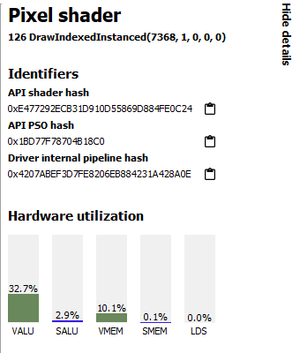
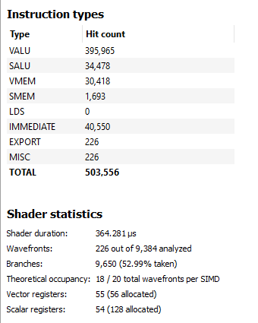
Instruction timing

Slide 40
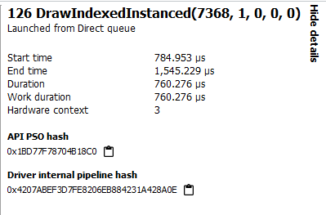
Instruction timing - Workflow
Step 1: Identify API PSO hash for shader of interest

Slide 41
Instruction timing - Workflow
Step 2: Tell Radeon™ Developer Panel that you want detailed instruction tracing for that API PSO

Slide 42
Group by API PSO

Slide 43
Color by API PSO

Slide 44
COLOR by Instruction timing

Slide 45
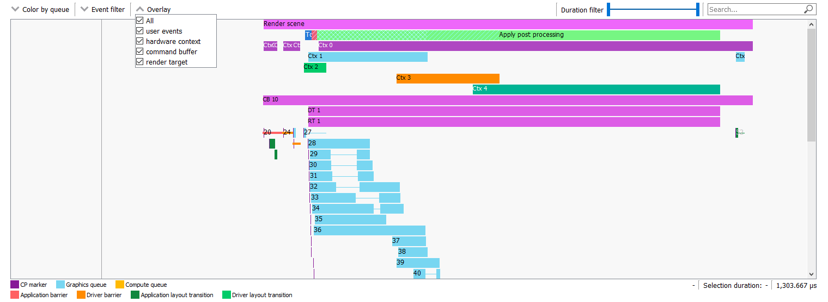
Event Timeline Overlays

Slide 46
THANK YOU
Find out more at GPUOpen
www.gpuopen.com
Download RGP from GitHub:
https://github.com/GPUOpen-Tools/radeon_gpu_profiler/releases

Slide 47
Copyright & Disclaimer
© 2020 Advanced Micro Devices, Inc. All rights reserved.
AMD, the AMD Arrow logo, Radeon and combinations thereof are trademarks of Advanced Micro Devices, Inc. Other product names used in this publication are for identification purposes only and may be trademarks of their respective companies.
DirectX® is a registered trademark of Microsoft Corporation in the US and other jurisdictions.
Linux® is the registered trademark of Linus Torvalds in the U.S. and other countries.
OpenCL™ is a trademark of Apple Inc. used by permission by Khronos Group, Inc.
OpenGL® and the oval logo are trademarks or registered trademarks of Hewlett Packard Enterprise in the United States and/or other countries worldwide.
Vulkan® and the Vulkan logo are registered trademarks of the Khronos Group Inc.
Windows® is a registered trademark of Microsoft Corporation in the US and other jurisdictions.
Disclaimer
The information presented in this document is for informational purposes only and may contain technical inaccuracies, omissions, and typographical errors. The information contained herein is subject to change and may be rendered inaccurate for many reasons, including but not limited to product and roadmap changes, component and motherboard version changes, new model and/or product releases, product differences between differing manufacturers, software changes, BIOS flashes, firmware upgrades, or the like. Any computer system has risks of security vulnerabilities that cannot be completely prevented or mitigated. AMD assumes no obligation to update or otherwise correct or revise this information. However, AMD reserves the right to revise this information and to make changes from time to time to the content hereof without obligation of AMD to notify any person of such revisions or changes.
THIS INFORMATION IS PROVIDED ‘AS IS.” AMD MAKES NO REPRESENTATIONS OR WARRANTIES WITH RESPECT TO THE CONTENTS HEREOF AND ASSUMES NO RESPONSIBILITY FOR ANY INACCURACIES, ERRORS, OR OMISSIONS THAT MAY APPEAR IN THIS INFORMATION. AMD SPECIFICALLY DISCLAIMS ANY IMPLIED WARRANTIES OF NON-INFRINGEMENT, MERCHANTABILITY, OR FITNESS FOR ANY PARTICULAR PURPOSE. IN NO EVENT WILL AMD BE LIABLE TO ANY PERSON FOR ANY RELIANCE, DIRECT, INDIRECT, SPECIAL, OR OTHER CONSEQUENTIAL DAMAGES ARISING FROM THE USE OF ANY INFORMATION CONTAINED HEREIN, EVEN IF AMD IS EXPRESSLY ADVISED OF THE POSSIBILITY OF SUCH DAMAGES.

Slide 48
Curing Amnesia and other GPU maladies with AMD developer tools
Amit Ben-Moshe, Chris Hesik, Gordon Selley

Slide 49
ABOUT THIS Presentation
Update on the RadeonTM GPU Analyzer
What’s new with the RadeonTM GPU Profiler
The new AMD RadeonTM Memory Visualizer

Slide 50
The new AMD Radeon™ Memory visualizer
Authored and presented by Gordon Selley

Slide 51
Radeon™ Memory visualizer (RMV)
The origins of RMV

Slide 52
Radeon™ Memory visualizer (RMV)
The origins of RMV
A new GPU memory analysis tool from AMD
Reveals how graphics applications use GPU memory over time
Works in a similar way to RGP
Controlled by the Radeon™ Developer Panel
Support built into the Radeon™ public driver
Supports DirectX® 12 and Vulkan® on Windows®
Memory trace files are small (2-200MB)

Slide 53
RMV – Answers GPU memory questions
How much VRAM am I using?
Am I close to oversubscribing?
Which are my biggest resources?
Which are my biggest allocations?
How efficiently am I sub-allocating?
When did my resource get uploaded?
Did I leak or orphan any allocations or resources (i.e., page fault bait)?
Are there unbound or unused resources?
In which heap did my allocation end up?
Did I forget to remove resources when no longer needed?

Slide 54
RMV Timeline View

Slide 55
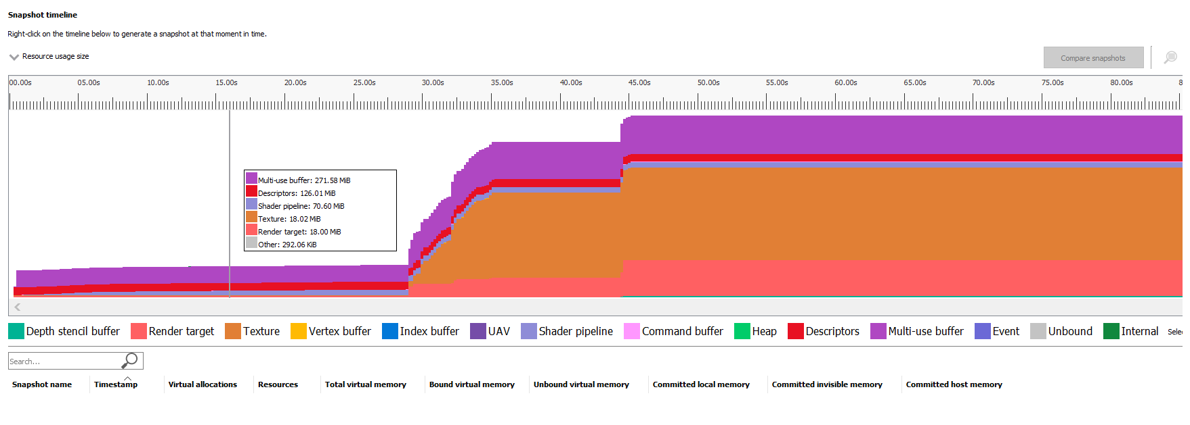
RMV Timeline View

Slide 56
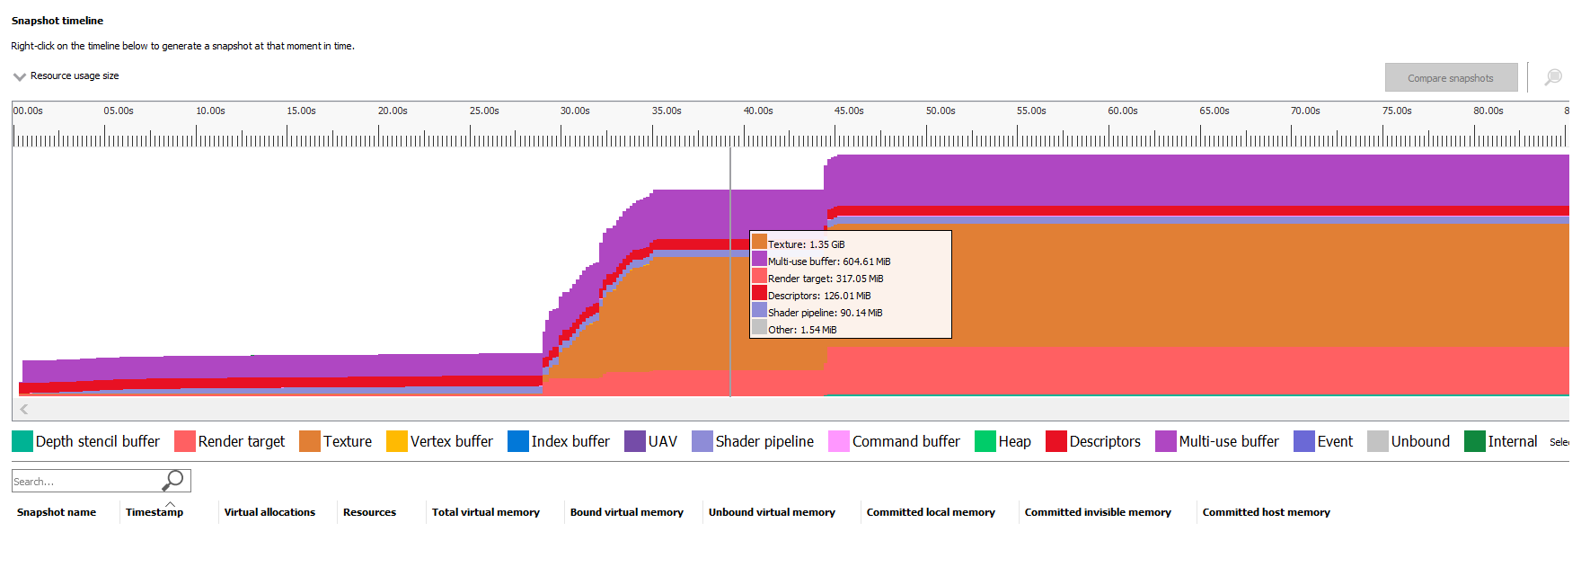
RMV Timeline View

Slide 57
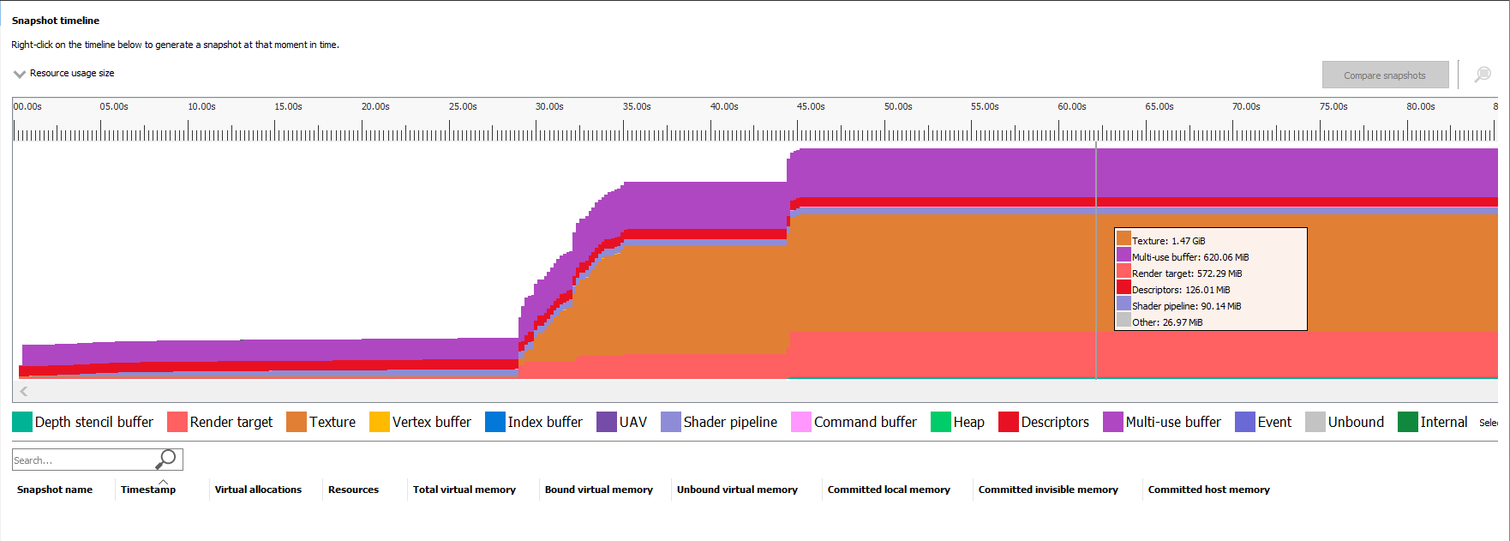
RMV Timeline View

Slide 58
RMV Timeline View
User creates memory snapshot at 16.75 seconds

Slide 59
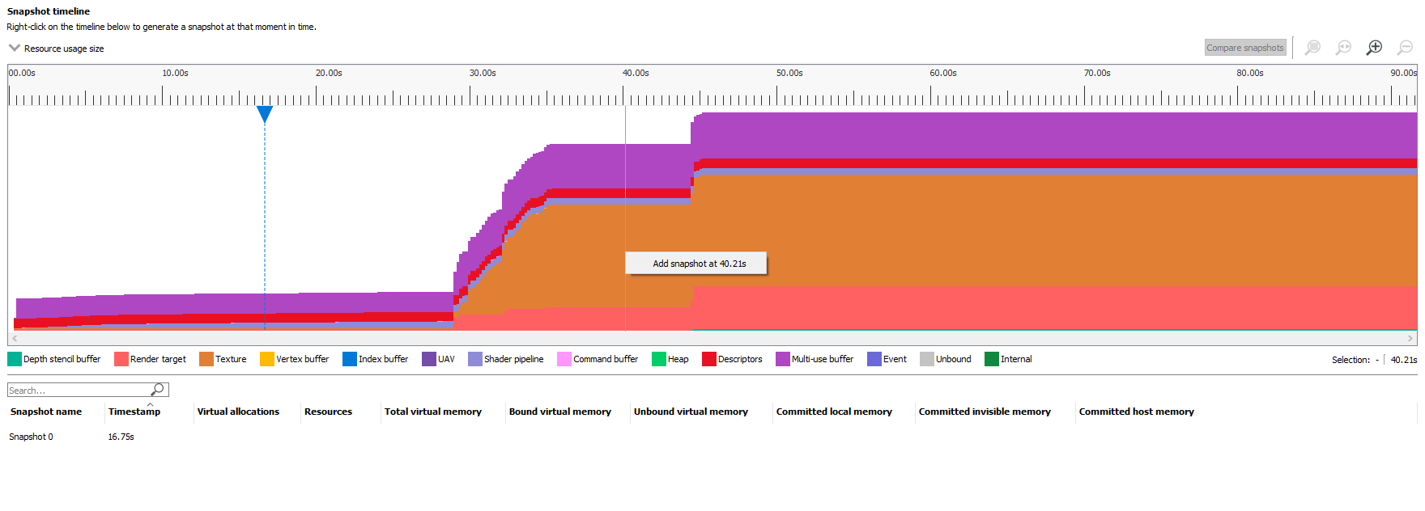
RMV Timeline View
Create another snapshot
Snapshot appear in list below

Slide 60
RMV Timeline View
Create another snapshot

Slide 61
RMV Timeline View

Slide 62
RMV Heap Overview

Slide 63
RMV Heap Overview
Q2. Am I close to oversubscribing?
Q1. How much VRAM am I using?

Slide 64
RMV Resource Overview

Slide 65
RMV Resource Overview

Slide 66
RMV Resource Overview

Slide 67
RMV Resource Overview

Slide 68
RMV Resource Overview

Slide 69
RMV Resource Overview

Slide 70
RMV Resource Overview

Slide 71
RMV Resource Overview

Slide 72
RMV Resource Overview

Slide 73
RMV Resource Overview
Q3. Which are my biggest resources?

Slide 74
RMV Resource Overview

Slide 75
RMV Resource Overview

Slide 76
RMV Resource Overview

Slide 77
RMV Resource Overview

Slide 78
RMV Resource Overview

Slide 79
RMV Allocation Overview
Q4. Which are my biggest allocations?

Slide 80
RMV Allocation Overview

Slide 81
RMV Allocation Overview

Slide 82
RMV Allocation Overview
Q5. How efficiently am I sub-allocating?

Slide 83
RMV Allocation Explorer
Selected allocation
Resources in selected allocation
Allocation list

Slide 84
RMV Resource Details
Resource event timeline
Resource details
Q6. When did my resources get uploaded?
Resource event list

Slide 85
RMV Resource List

Slide 86
RMV Resource List

Slide 87
RMV Resource List

Slide 88
RMV Resource List

Slide 89
RMV Resource List

Slide 90
RMV Resource List

Slide 91
RMV Resource List

Slide 92
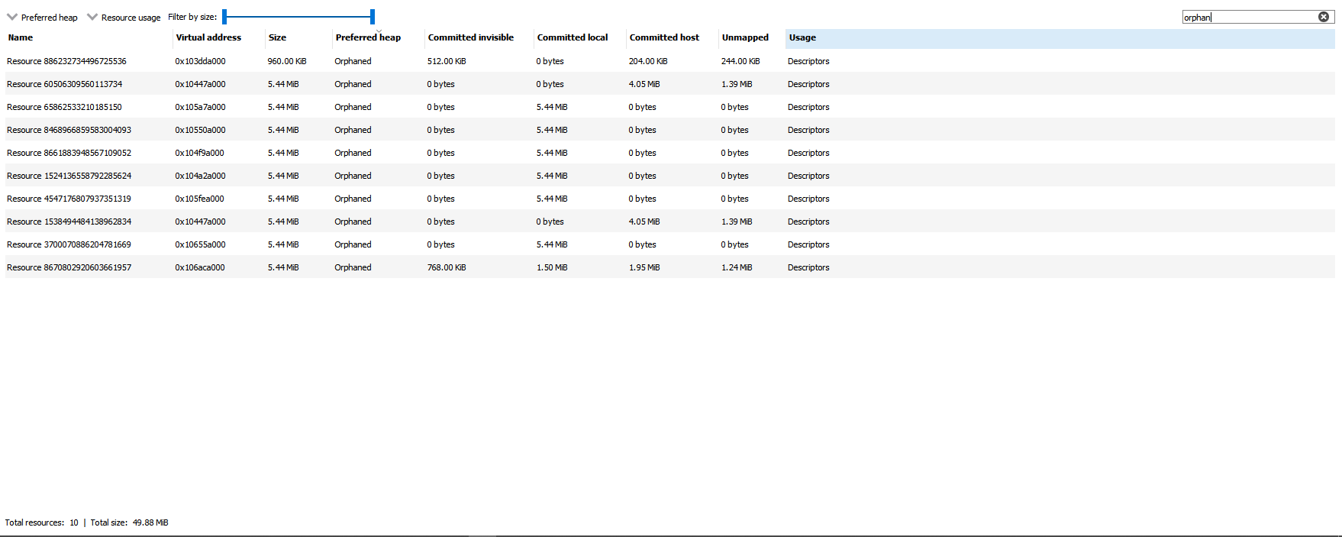
RMV Resource List
Search for “orphan”
Q7. Did I leak or orphan any allocations or resources?

Slide 93
RMV Resource Overview
Q8. Are there unbound or unused resources?

Slide 94
RMV Resource Overview
Include unbound allocations

Slide 95
RMV Resource Overview
Unbound virtual memory

Slide 96
RMV Allocation Explorer
2MB in size
0 bytes bound
2MB unbound
no resources

Slide 97
RMV Allocation Explorer
16MB size
14.85MB bound
1.15MB unbound
49 resources

Slide 98
RMV Resource Overview
Q9. In which heap did my allocation end up?

Slide 99
RMV Resource Overview

Slide 100
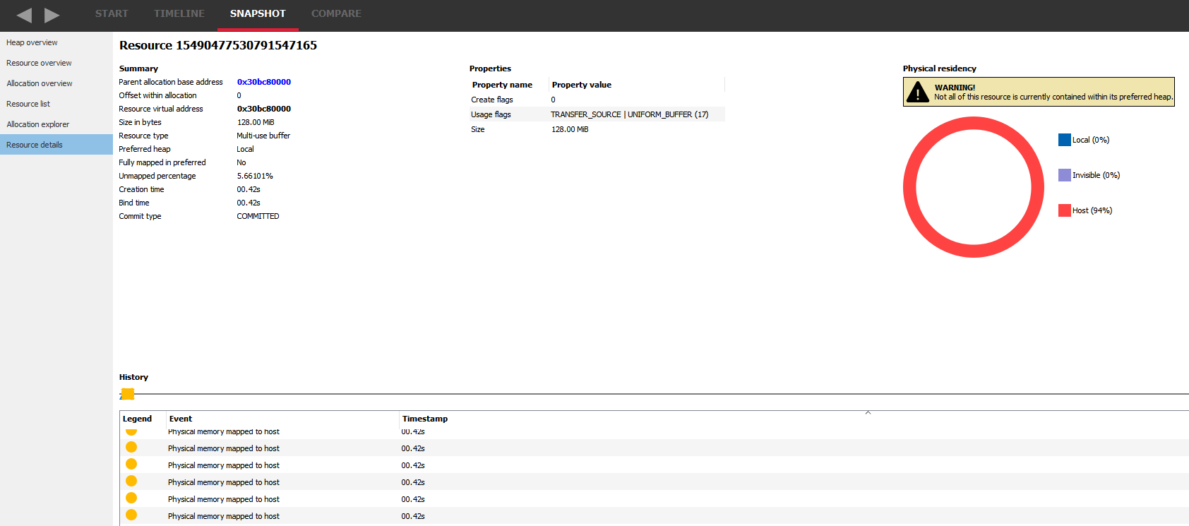
RMV Resource Overview

Slide 101
RMV Resource Overview

Slide 102
RMV Snapshot compare
End of scene 1
Start of scene 2

Slide 103
RMV Snapshot compare

Slide 104
RMV Snapshot compare

Slide 105
RMV Snapshot compare

Slide 106
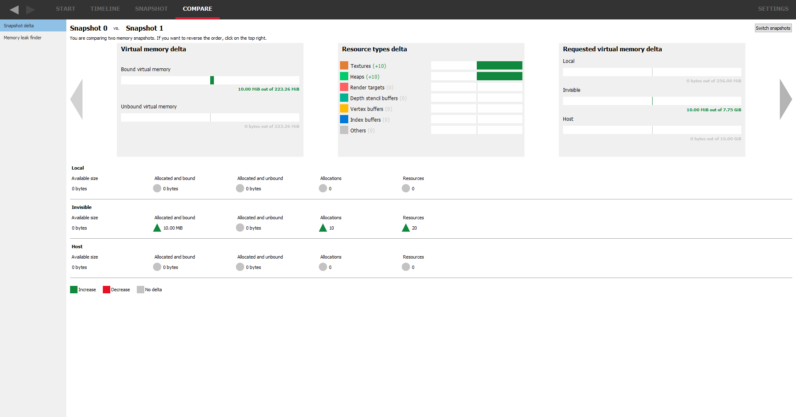
RMV Snapshot compare

Slide 107
RMV Snapshot compare

Slide 108
RMV Snapshot compare

Slide 109
RMV Snapshot compare

Slide 110
RMV Snapshot compare
Memory leak fixed

Slide 111
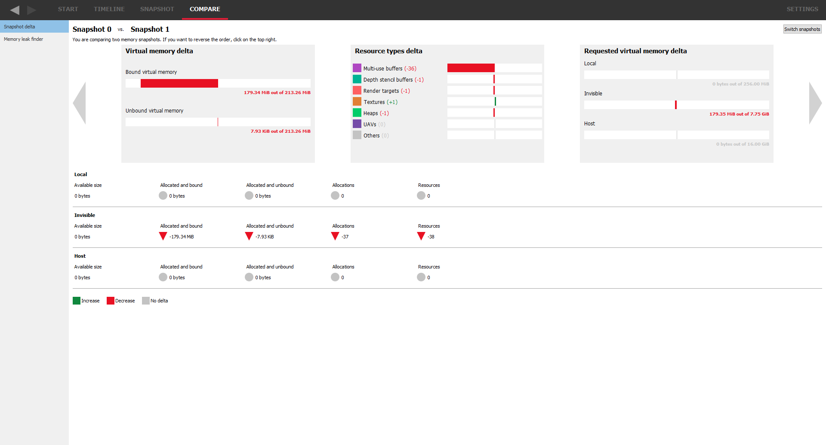
RMV Snapshot compare
Q10. Did I forget to remove resources when no longer needed?

Slide 112
THANK YOU
Find out more at GPUOpen
www.gpuopen.com
Download RMV from GitHub:
https://github.com/GPUOpen-Tools/radeon_memory_visualizer

Slide 113
Copyright & Disclaimer
© 2020 Advanced Micro Devices, Inc. All rights reserved.
AMD, the AMD Arrow logo, Radeon and combinations thereof are trademarks of Advanced Micro Devices, Inc. Other product names used in this publication are for identification purposes only and may be trademarks of their respective companies.
DirectX® is a registered trademark of Microsoft Corporation in the US and other jurisdictions.
Linux® is the registered trademark of Linus Torvalds in the U.S. and other countries.
OpenCL™ is a trademark of Apple Inc. used by permission by Khronos Group, Inc.
OpenGL® and the oval logo are trademarks or registered trademarks of Hewlett Packard Enterprise in the United States and/or other countries worldwide.
Vulkan® and the Vulkan logo are registered trademarks of the Khronos Group Inc.
Windows® is a registered trademark of Microsoft Corporation in the US and other jurisdictions.
Disclaimer
The information presented in this document is for informational purposes only and may contain technical inaccuracies, omissions, and typographical errors. The information contained herein is subject to change and may be rendered inaccurate for many reasons, including but not limited to product and roadmap changes, component and motherboard version changes, new model and/or product releases, product differences between differing manufacturers, software changes, BIOS flashes, firmware upgrades, or the like. Any computer system has risks of security vulnerabilities that cannot be completely prevented or mitigated. AMD assumes no obligation to update or otherwise correct or revise this information. However, AMD reserves the right to revise this information and to make changes from time to time to the content hereof without obligation of AMD to notify any person of such revisions or changes.
THIS INFORMATION IS PROVIDED ‘AS IS.” AMD MAKES NO REPRESENTATIONS OR WARRANTIES WITH RESPECT TO THE CONTENTS HEREOF AND ASSUMES NO RESPONSIBILITY FOR ANY INACCURACIES, ERRORS, OR OMISSIONS THAT MAY APPEAR IN THIS INFORMATION. AMD SPECIFICALLY DISCLAIMS ANY IMPLIED WARRANTIES OF NON-INFRINGEMENT, MERCHANTABILITY, OR FITNESS FOR ANY PARTICULAR PURPOSE. IN NO EVENT WILL AMD BE LIABLE TO ANY PERSON FOR ANY RELIANCE, DIRECT, INDIRECT, SPECIAL, OR OTHER CONSEQUENTIAL DAMAGES ARISING FROM THE USE OF ANY INFORMATION CONTAINED HEREIN, EVEN IF AMD IS EXPRESSLY ADVISED OF THE POSSIBILITY OF SUCH DAMAGES.

